Slide 1
The Smartphone Project
Building a Smartphone From Scratch

Slide 2
Short and Concise SMART Goals
Build a fully functional smartphone
Prove that learning to build a smartphone from scratch doesn’t have to be a mystery
S
M
A
R
T

Slide 3
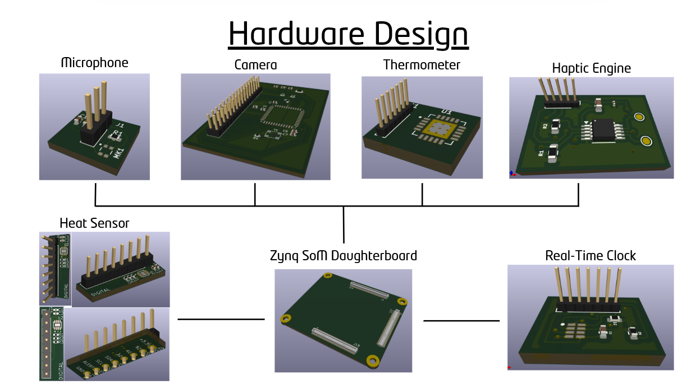
Disclaimer
…Hardware Design Team
We have multiple teams working on different aspects of the phone
  For the sake of simplicity, we will keep this presentation for the…
Notes:
Programmable Hardware enables
Ability for the AVERAGE PERSON to easily repair of various elements in a PRODUCT WE OWN
Ability to easily assemble/disassemble ALLOWS you to upgrade your perfectly good phone by replacing only the components on the phone that YOU want improved on your phone
Ability to make a modular phone, which would allow
YOU to make your phone distinctly YOURS (not an identical slab to everyone else)
YOU to decide what are important features to you and

Slide 4
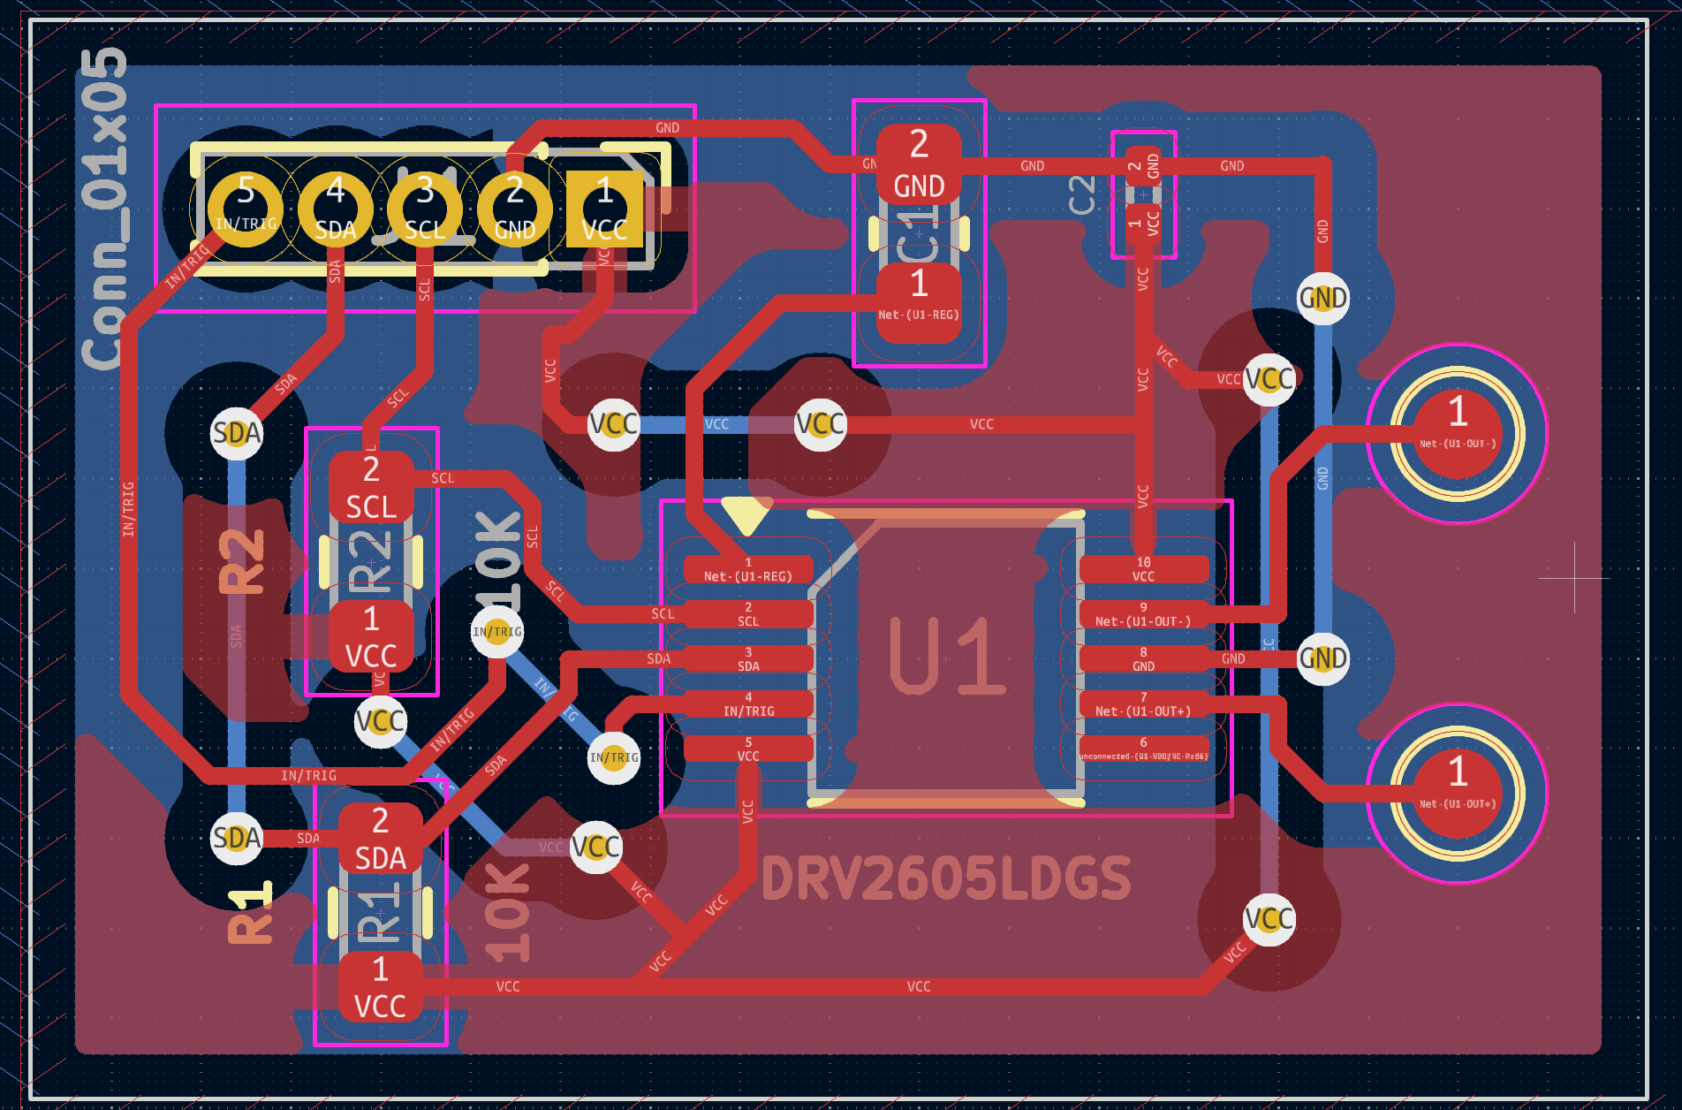
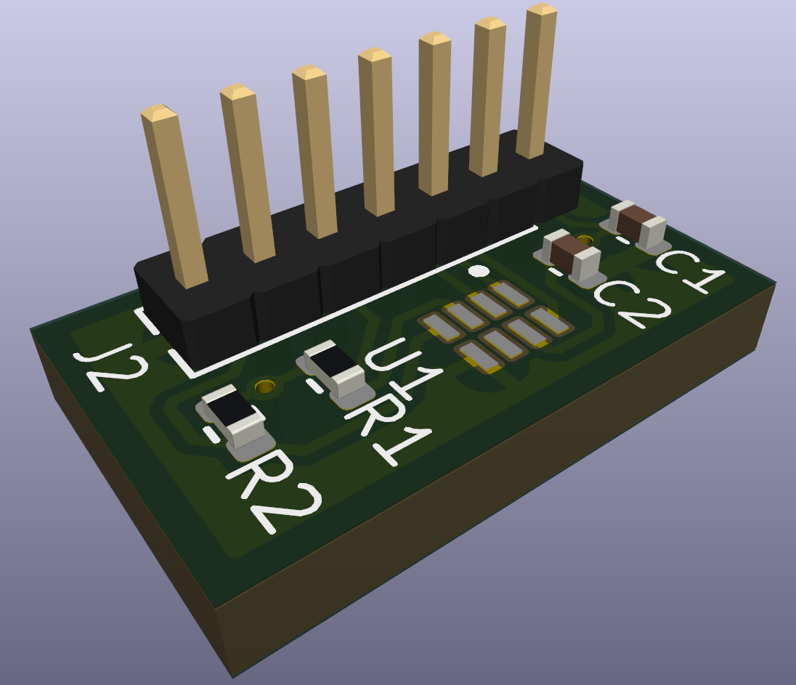
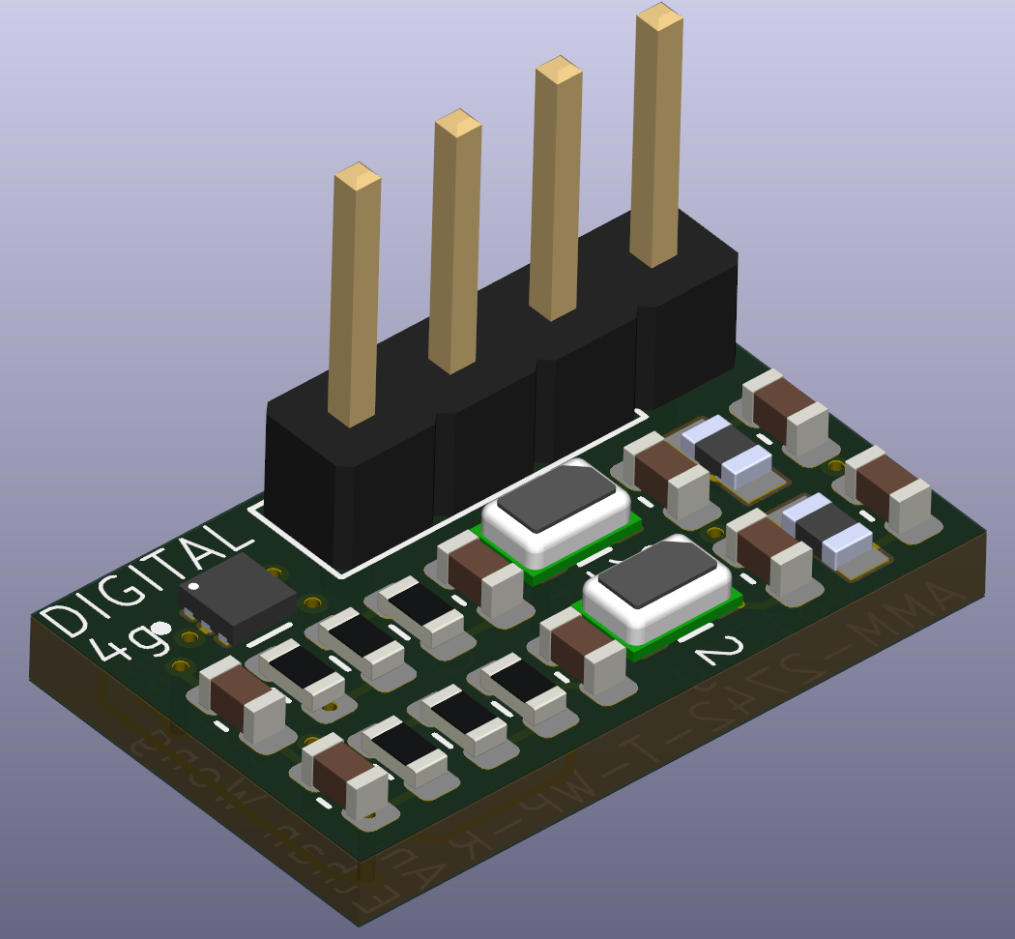
Quick Look at the Hardware Projects
Haptic Motor Driver [PCB Layout]
Real-Time Clock [3D Model]
Microphone [3D Model]
Haptic Motor Pads
Real-Time Clock Pads
Haptic Motor Driver
x2 Microphones
Creates Controlled Vibrations
Keeps Track of Time
Captures Audio Input
Notes:
Haptic Motor Driver
Haptic Motor Driver is necessary to control haptic motor vibration patterns
Haptic Motor works by converting electrical energy into mechanical vibrations
Communicates through I²C peripherals
Real-Time Clock
Real-Time Clock counts time by counting the pulses of a stable quartz crystal oscillator
Uses a battery backup to maintain power independently of main power system in case of power off
Communicates through I²C peripherals
Microphone
Microphone captures sound waves (analog) and converts them into electrical signals
Multiple microphones are used to overall reduce noise caused by individual noise
Communicates through I²C peripherals

Slide 5
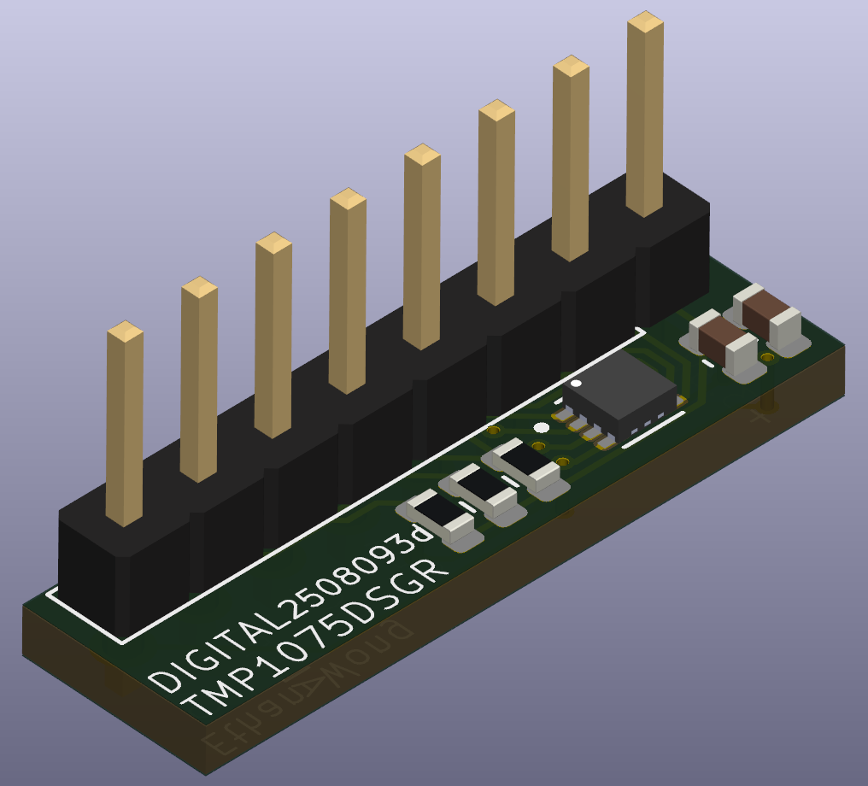
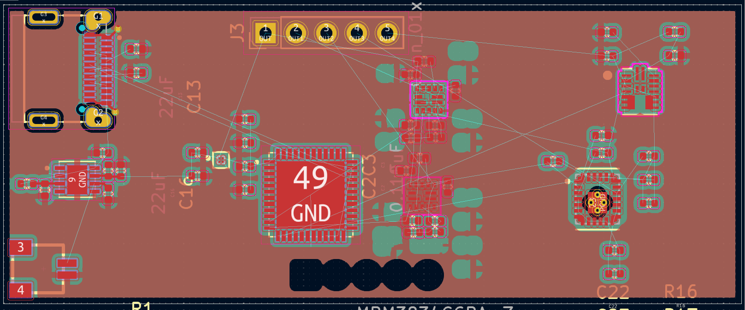
Quick Look at the Hardware Projects
Heat Sensor [3D Model]
System Controller [PCB Layout]
USB-C Receptacle
Heat Sensor
x4 Voltage Regulator
STM32 Microcontroller
Monitors Internal Heat
Controls Power Rails’ Functions
Notes:
Heat Sensor
Heat Sensor changes resistance (or another property) based on temperature
Communicates through I²C peripherals
System Controller
Utilizes microcontroller (STM32G431CBU6) to control enable pins of voltage regulators
FPGA requires its voltage regulators to turn on in a specific sequence (one cannot be turned on until the other is stable)
USB-C receptacle is used to program and communicate to the STM32 MCU

Slide 6
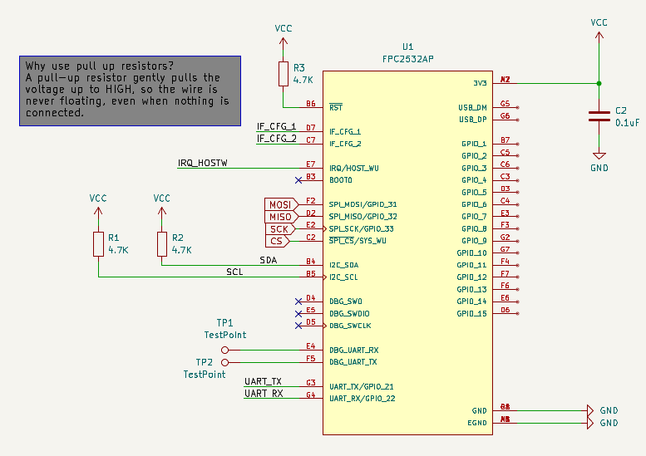
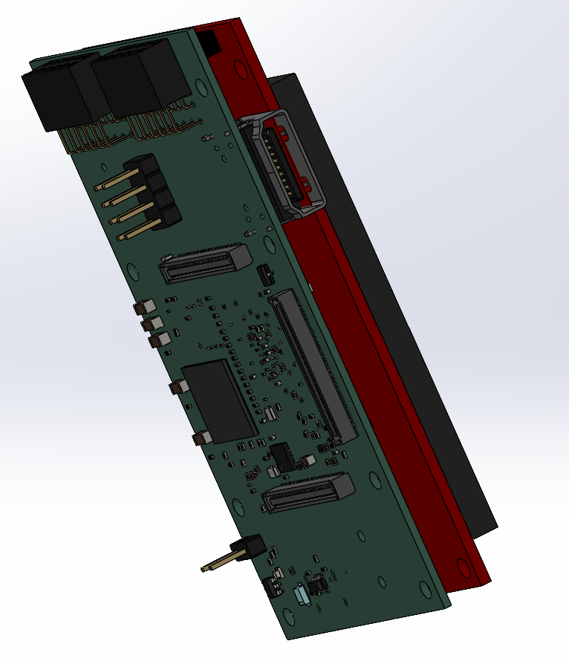
Quick Look at the Hardware Projects
Fingerprint Sensor [Schematic]
System on Module [3D Model]
Quick and Secure Way For User To Protect Phone
Motherboard
Notes:
Programmable Hardware enables
Ability for the AVERAGE PERSON to easily repair of various elements in a PRODUCT WE OWN
Ability to easily assemble/disassemble ALLOWS you to upgrade your perfectly good phone by replacing only the components on the phone that YOU want improved on your phone
Ability to make a modular phone, which would allow
YOU to make your phone distinctly YOURS (not an identical slab to everyone else)
YOU to decide what are important features to you and

Slide 7
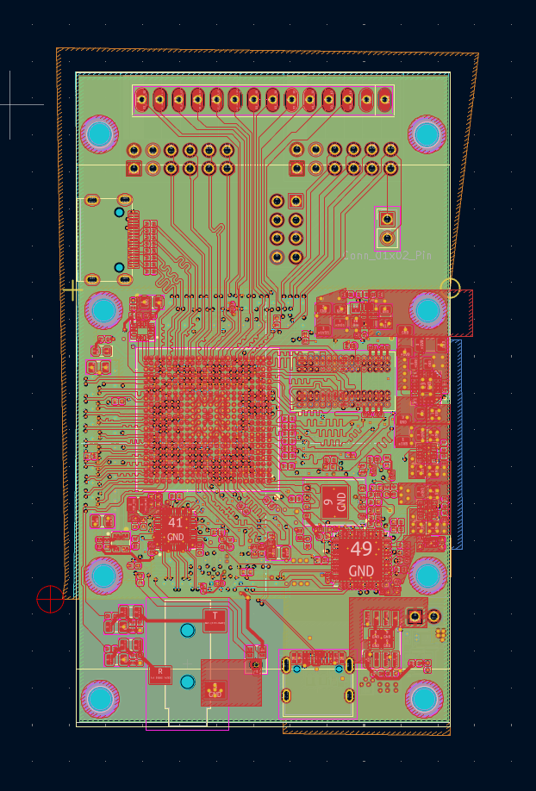
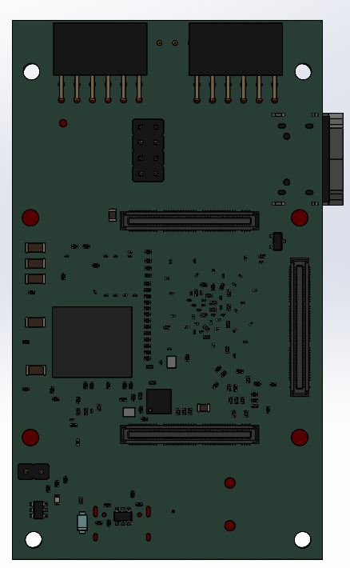
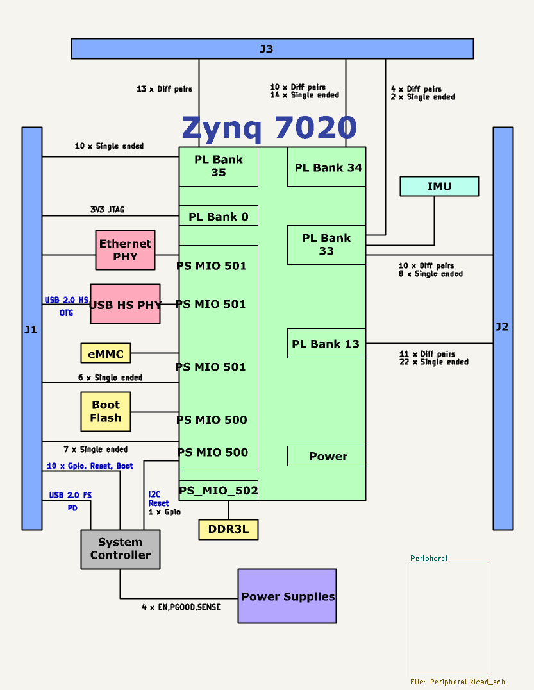
Hardware Design: Motherboard (System on Module)
Notes:
Haptic Motor Driver
Haptic Motor Driver is necessary to control haptic motor vibration patterns
Haptic Motor works by converting electrical energy into mechanical vibrations
Communicates through I²C peripherals
Real-Time Clock
Real-Time Clock counts time by counting the pulses of a stable quartz crystal oscillator
Uses a battery backup to maintain power independently of main power system in case of power off
Communicates through I²C peripherals
Microphone
Microphone captures sound waves (analog) and converts them into electrical signals
Multiple microphones are used to overall reduce noise caused by individual noise
Communicates through I²C peripherals

Slide 8
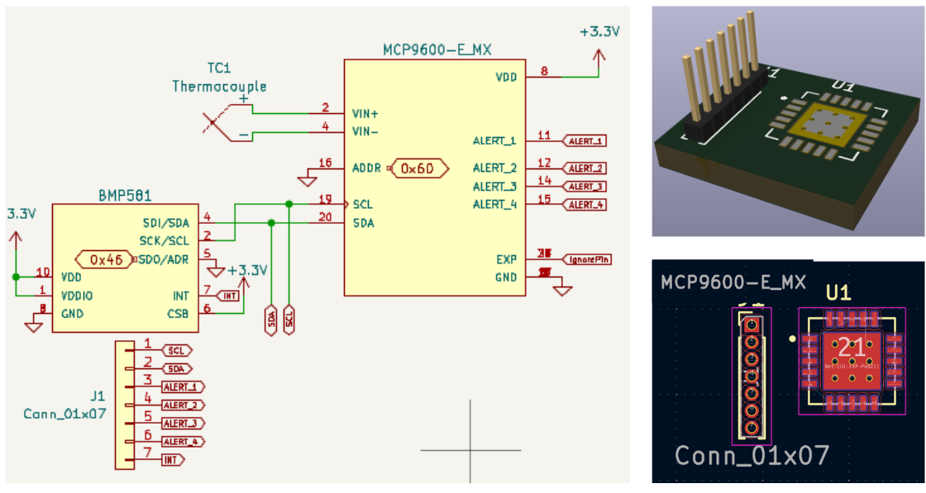
Hardware Design: Thermometer and Barometer
Notes:
Project Definition
Consumer Need: Fast, secure, and user-friendly authentication → convenience and privacy
Feature: Allow users to unlock the device and verify their identity with a single touch
Purpose: Personal, Modern, and Secure
Determined the type of Fingerprint Sensor
Determined how the phone will communicate with these sensors
We then found the sensor, implemented the schematic, then converted that schematic to a 3D modeled version

Slide 9
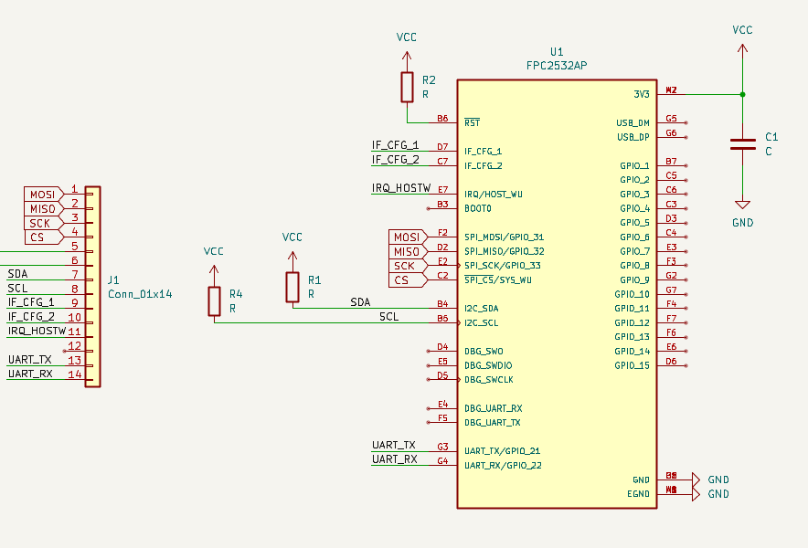
Hardware Design: Fingerprint Sensor
Notes:
Project Definition
Consumer Need: Fast, secure, and user-friendly authentication → convenience and privacy
Feature: Allow users to unlock the device and verify their identity with a single touch
Purpose: Personal, Modern, and Secure
Determined the type of Fingerprint Sensor
Determined how the phone will communicate with these sensors
We then found the sensor, implemented the schematic, then converted that schematic to a 3D modeled version

Slide 10
Hardware Design: STM32 Microcontroller
USB-C Receptacle
x4 Voltage Regulator
STM32 Microcontroller
Notes:
Project Definition
Consumer Need: Fast, secure, and user-friendly authentication → convenience and privacy
Feature: Allow users to unlock the device and verify their identity with a single touch
Purpose: Personal, Modern, and Secure
Determined the type of Fingerprint Sensor
Determined how the phone will communicate with these sensors
We then found the sensor, implemented the schematic, then converted that schematic to a 3D modeled version

Slide 11
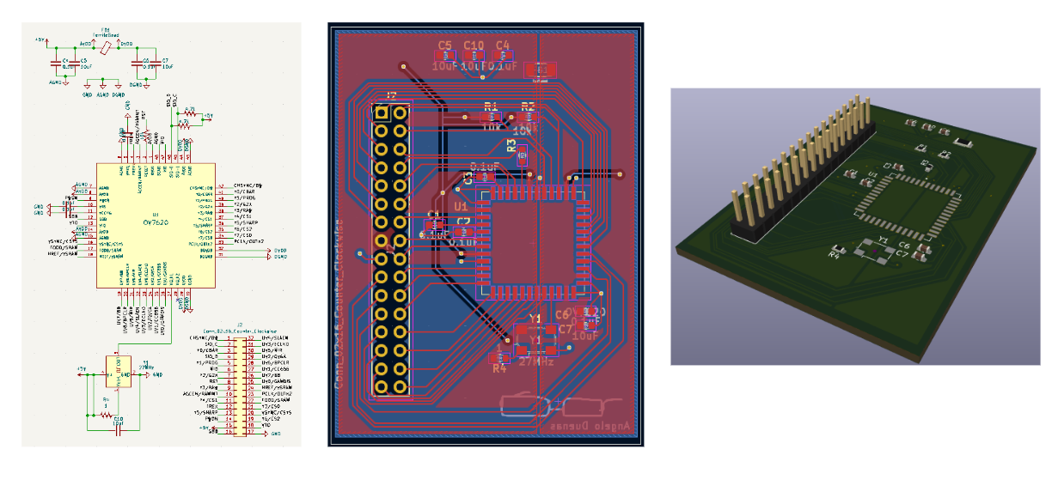
Hardware Design: Camera
Notes:
Project Definition
Consumer Need: Fast, secure, and user-friendly authentication → convenience and privacy
Feature: Allow users to unlock the device and verify their identity with a single touch
Purpose: Personal, Modern, and Secure
Determined the type of Fingerprint Sensor
Determined how the phone will communicate with these sensors
We then found the sensor, implemented the schematic, then converted that schematic to a 3D modeled version

Slide 12
Thank you

Slide 13
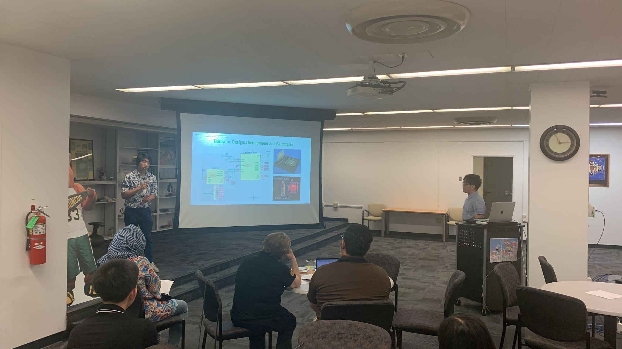
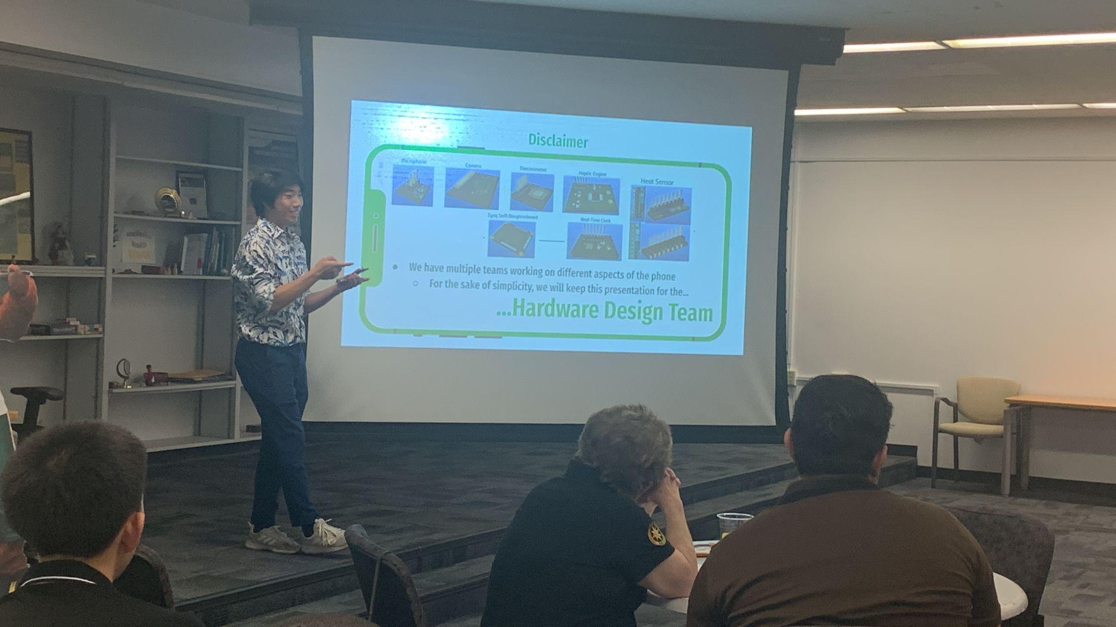
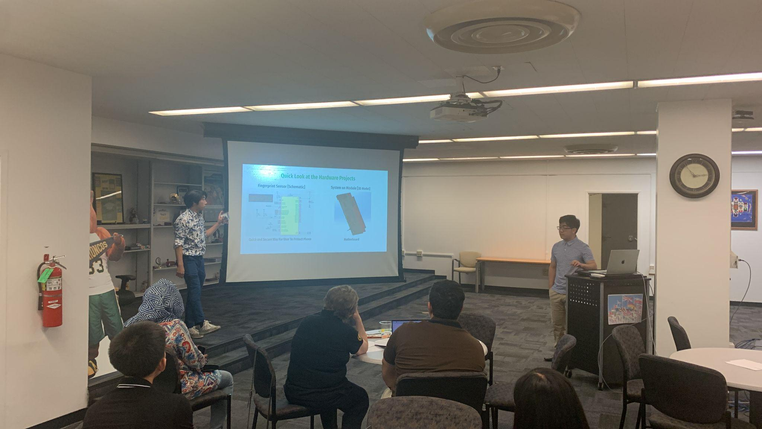

Slide 14
